Slide 1
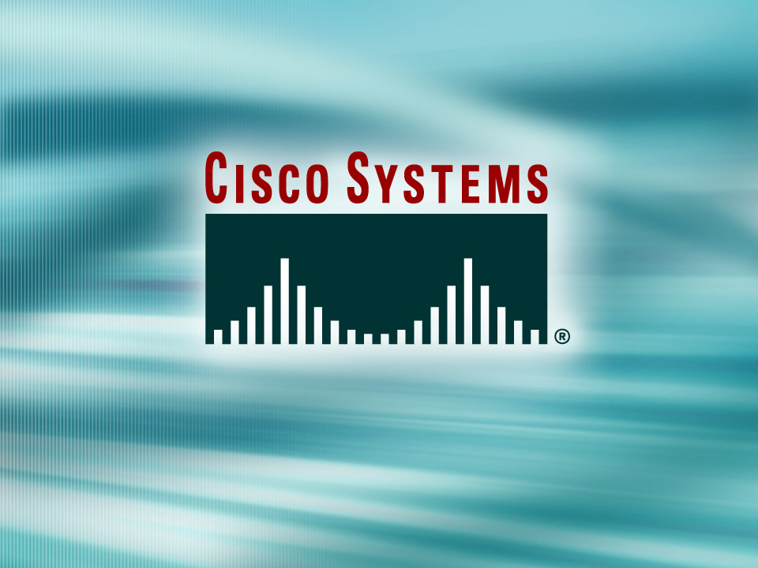
© 2002, Cisco Systems, Inc. All rights reserved.

Slide 2

Link-State and Balanced Hybrid Routing
© 2002, Cisco Systems, Inc. All rights reserved.
Notes:
Purpose: This chapter introduces the Cisco IOS™ CLI on the Catalyst® 1900 switch and router.
Timing: This chapter should take about 2 hours to present.
Note: The Catalyst 1900 switch only has a subset of the router Cisco IOS commands available.
Contents:
Introduction to Cisco IOS. Explain to the student what is IOS?
Cisco Device startup procedures in general.
IOS configuration source.
General introduction to the IOS CLI.
Cat 1900 switch startup procedures.
Intro to Cat 1900 CLI. This part covers the basic configuration on the switch, like setting the IP address and hostname. More details about the various Cat 1900 switch configuration commands are explained in Chapter 6 and 7.
Router startup procedures. More details on the router startup process is discussed in chapter 5.
Router IOS CLI.

Slide 3
Objectives
Upon completing this lesson, you will be able to:
  Describe the issues associated with link-state routing and identify solutions to those issues
  Describe the features of balanced hybrid routing protocols
Notes:
Slide 1 of 2
Purpose: This slide states the chapter objectives.
Emphasize: Read or state each objective so that each student has a clear understanding of the chapter objectives.
Note: Catalyst switches have different CLIs. The Catalyst 2900xl and the Catalyst 1900 has a Cisco IOS CLI. The Cisco IOS CLI commands available on the 2900xl is different from the 1900. The Catalyst 5000 family has no Cisco IOS CLI, and use the set commands instead. This class only covers the configuration on the Catalyst 1900 switch.

Slide 4
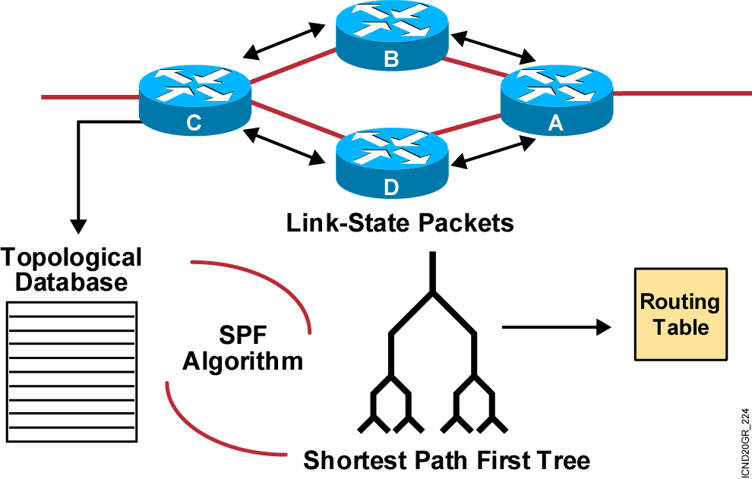
Link-State Routing Protocols
After initial flood, pass small event-triggered link-state
updates to all other routers
Notes:
Purpose: This figure introduces the link-state routing algorithm, the second of the classes of routing protocols, and outlines how it operates.
Emphasize: In contrast with the analogy about the distance vector information being like individual road signs that show distance, link-state information is somewhat analogous to a road map with a “you are here” pointer showing the map reader’s current location. This larger perspective indicates the shortest path to the destination. Each router has its own map of the complete topology.
Link-state routing is not covered further in this course. Refer students interested in more details to the ACRC course.

Slide 5
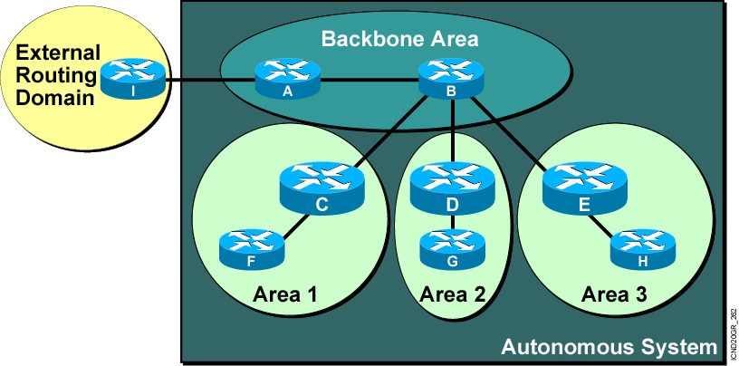
Link-State Network Hierarchy Example
  Minimizes routing table entries
  Localizes impact of a topology change within
  an area
Notes:
Summarizing is the consolidation of multiple routes into one single advertisement. Proper summarization requires contiguous addressing.
Route summarization directly affects the amount of bandwidth, CPU, and memory resources consumed by the OSPF process. With summarization, if a network link fails, the topology change will not be propagated into the backbone (and other areas by way of the backbone). As such, flooding outside the area will not occur, so routers outside of the area with the topology change will not have to run the SPF algorithm (also called the Dijkstra algorithm after the computer scientist who invented it). Running the SPF algorithm is a CPU-intensive activity.
There are two types of summarization:
Interarea route summarization—Interarea route summarization is done on ABRs and applies to routes from within the autonomous system. It does not apply to external routes injected into OSPF via redistribution. In order to take advantage of summarization, network numbers in areas should be assigned in a contiguous way so as to be able to consolidate these addresses into one range. This graphic illustrates interarea summarization.
External route summarization—External route summarization is specific to external routes that are injected into OSPF via redistribution. Here again, it is important to ensure that external address ranges that are being summarized are contiguous. Summarization overlapping ranges from two different routers could cause packets to be sent to the wrong destination.

Slide 6
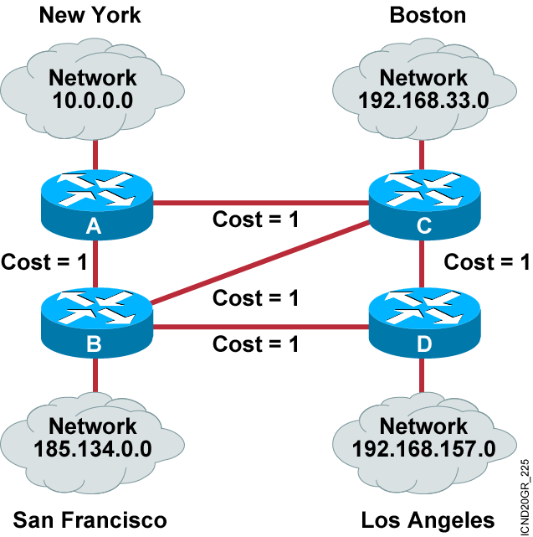
Link-State Routing
Protocol Algorithms

Slide 7
Benefits of Link-State Routing
  Fast convergence: changes are reported immediately by the source affected.
  Robustness against routing loops:
    Routers know the topology.
    Link-state packets are sequenced and acknowledged.
  By careful (hierarchical) network design, you can utilize resources optimally.

Slide 8
Caveats of Link-State Routing
  Significant demands for resources:
    Memory (three tables: adjacency, topology, forwarding)
    CPU (Dijkstra’s algorithm can be intensive, especially when a lot of instabilities are present.)
  Requires very strict network design (when more areas—area routing)
  Problems with partitioning of areas
  Configuration generally simple but can be complex
  when tuning various parameters and when the design is complex
  Troubleshooting easier than in distance vector routing

Slide 9
Drawbacks to Link-State Routing Protocols
  Initial discovery may cause flooding.
  Memory- and processor-intensive.

Slide 10
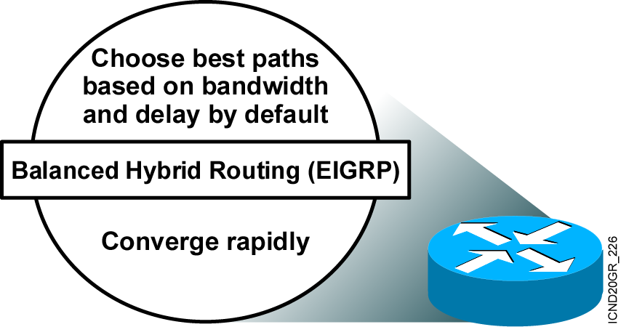
Balanced Hybrid Routing
Shares attributes of both distance vector
and link-state routing
Notes:
Purpose: This figure introduces and describes a third routing protocol class, the balanced hybrid.
Emphasize: Indicate how balance hybrid protocols such as Enhanced IGRP operate with elements of both distance vector and link-state routing protocols.
The EIGRP balanced hybrid routing protocol is covered in the ACRC course, not in this course.

Slide 11
Summary
  Link-state routing uses LSAs, a topological database, the SPF algorithm, the resulting SPF tree, and a routing table of paths and ports to each network.
  Link-state routing algorithms maintain a complex database of the network's topology by exchanging LSAs with other routers in a network.
  Link-state routing may flood the network with LSAs during initial topology discovery and can be both memory- and processor-intensive.
  Balanced hybrid routing protocols combine aspects of both distance vector and link-state protocols.

Slide 12
